Slide 1
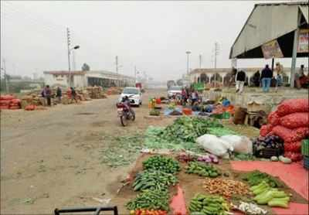
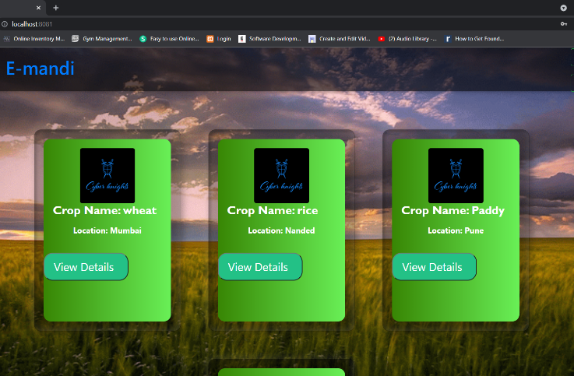
E-Mandi
Presented By
Sumit Sabbinwar - 210543181108
Omkar Dalvi – 210543181056
Aditya Mohite – 210543181052
Shraddha Kadam - 210543181103

Slide 2
Content
Abstract
Objective
Technologies
Flowchart
Drawback of conventional trading
Advantages
Future Scope

Slide 3
Abstract
E-Mandi is the most effective use of the World Wide Web for raw food industry. The primary goal of E-Mandi site is to make Mandi online to reduce time and increase productivity of both farmer as well as buyer. Providing an online approach towards trading of vegetables not only reduces time but also increases the efficiency of the trading process as well as keeps transparency throughout the process. E-Mandi makes use of latest technologies to build interactive interface between farmers and traders.

Slide 4
Objective
To provide software environment for farmers to gain maximum profit.
To provide a buyer better choice for his investment.
To provide crops in estimated time.
To provide direct communication between farmer and buyer i.e. no need of middle person.
To provide transparency throughout the process.

Slide 5
Technologies
Front-End | Back-End | Database
React JS | Spring Boot, JSON Web Token | MySQL
React JS - React is a declarative, efficient, and flexible JavaScript library for building user interfaces. It lets you compose complex UIs from small and isolated pieces of code called “components”.
Spring Boot - Spring Boot (Spring Boot) is a tool that makes developing web application and micro services with Spring Framework faster and easier. The ability to create standalone applications.
JWT (JSON Web Token) - JSON Web Token, is an open standard used to share security information between two parties a client and a server. Each JWT contains encoded JSON objects, including a set of claims.
MySQL - MySQL is an Oracle-backed open source relational database
management system (RDBMS) based on Structured Query Language (SQL).

Slide 6
Farmer Panel
Farmer
Add crop
least bid amount
Farmer will login to the portal or will have to register if he is not a registered user.
After registration Farmer will login and farmer can add new crop and its details.
Farmer will set the least bid amount . And select bid and bidder. Sell their goods to that trader.

Slide 7
Trader Panel
Trader
View crops details
Give review
Trader will login or will have to register if he is not registered user.
After login Trader will select the crop that he want and place bid amount for the crops. Once the bid amount of trader gets selected then he will buy goods from farmer.
After buying the goods from farmer , the trader can give reviews for that goods in a form of rating and comments.

Slide 8
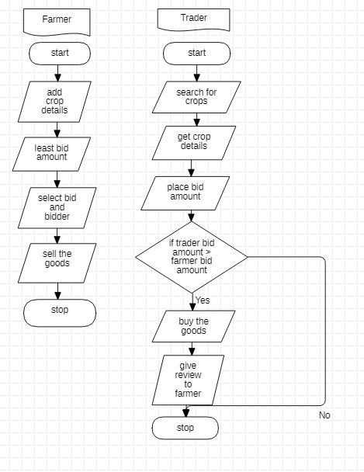
Flowchart

Slide 9
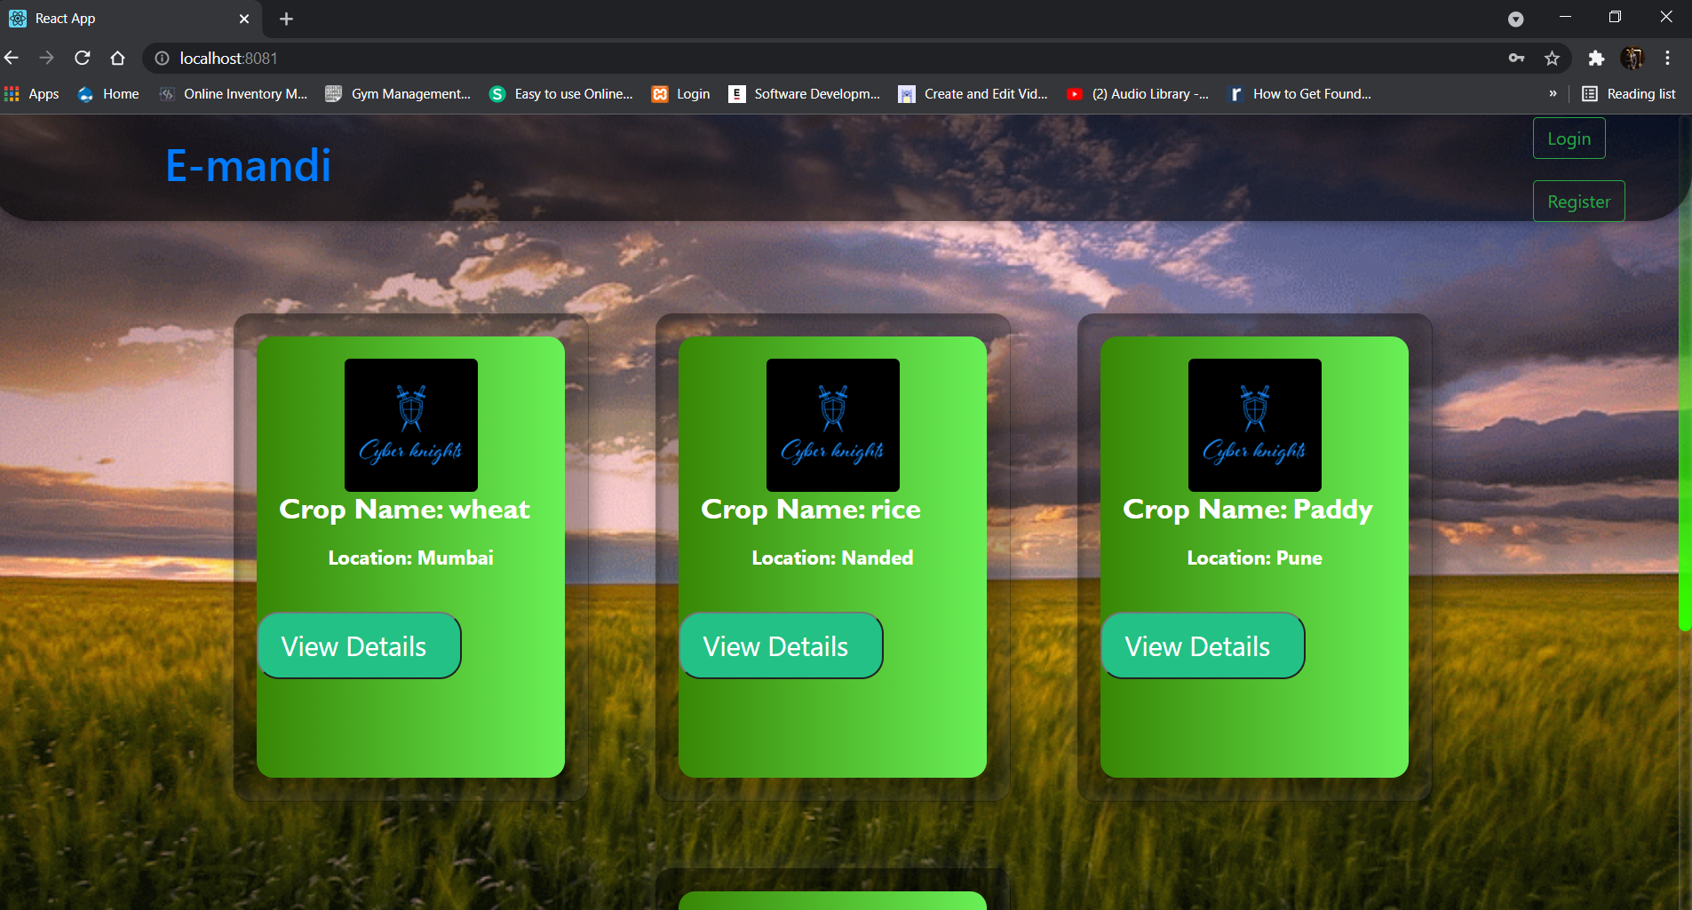

Slide 10
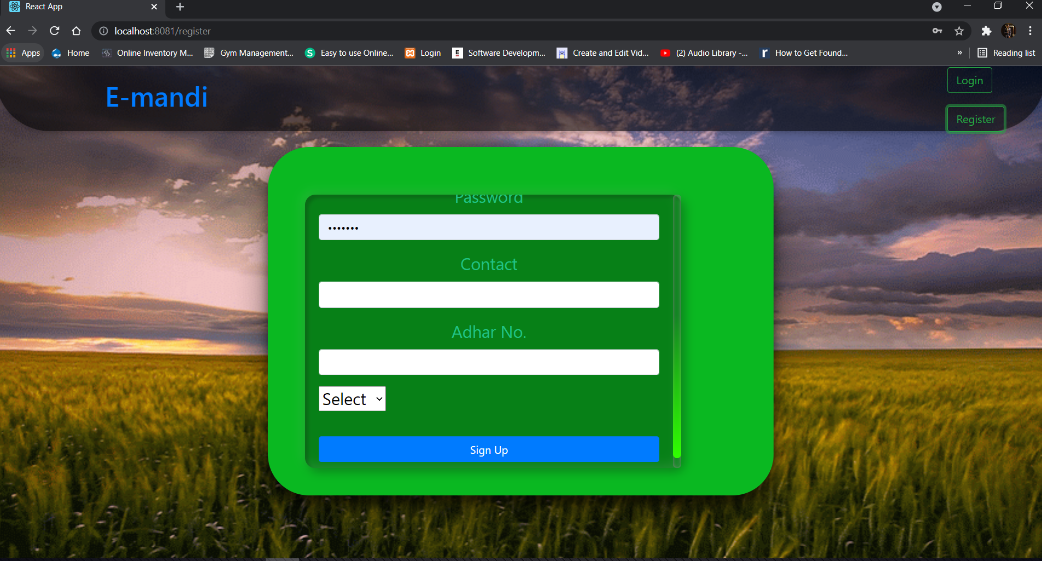

Slide 11
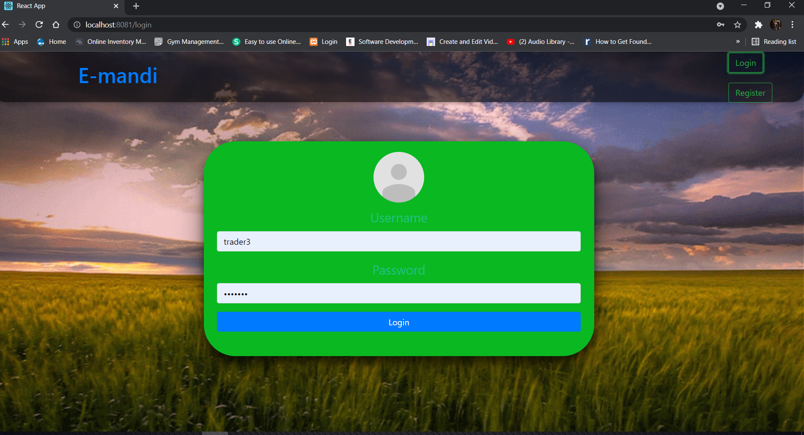

Slide 12
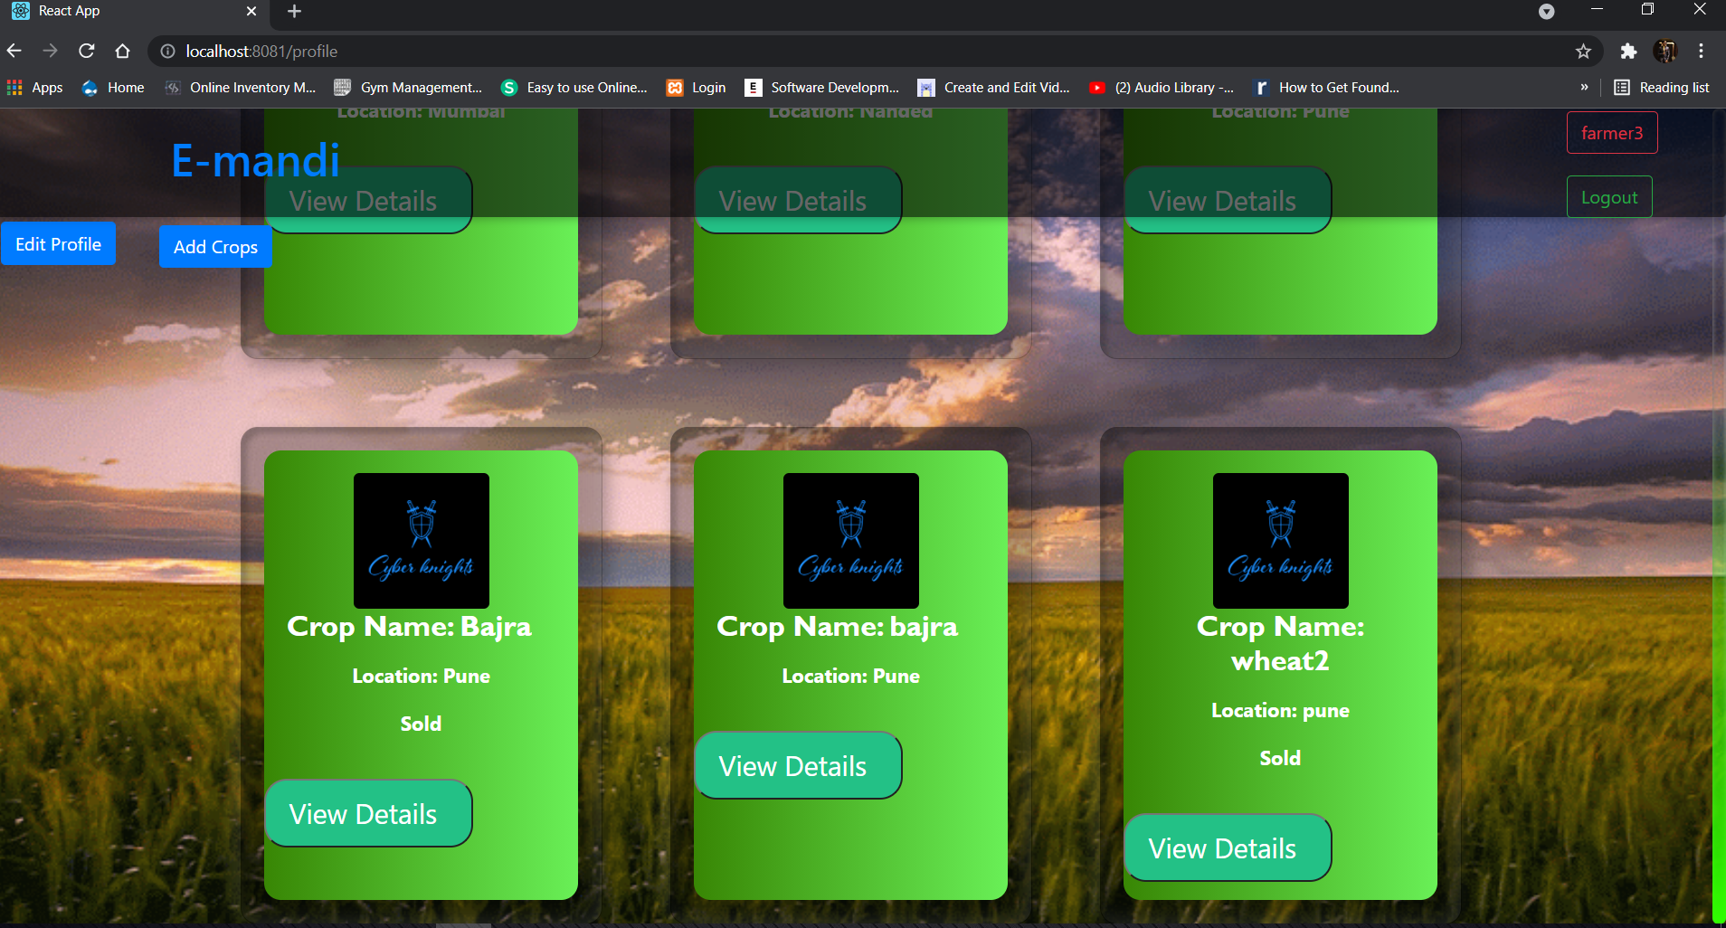

Slide 13
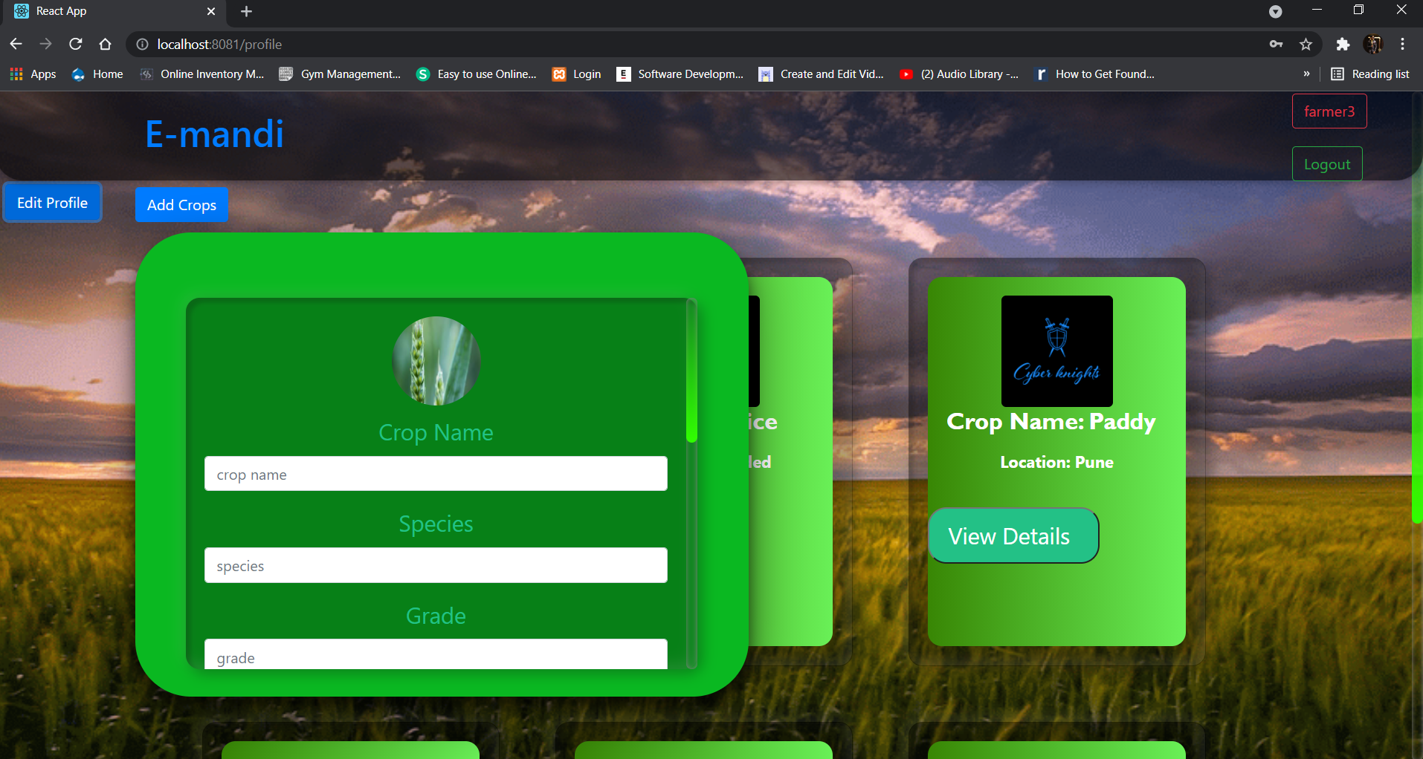

Slide 14
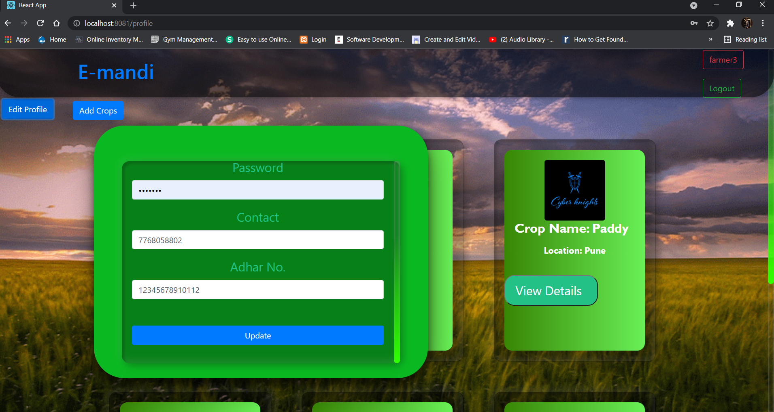

Slide 15
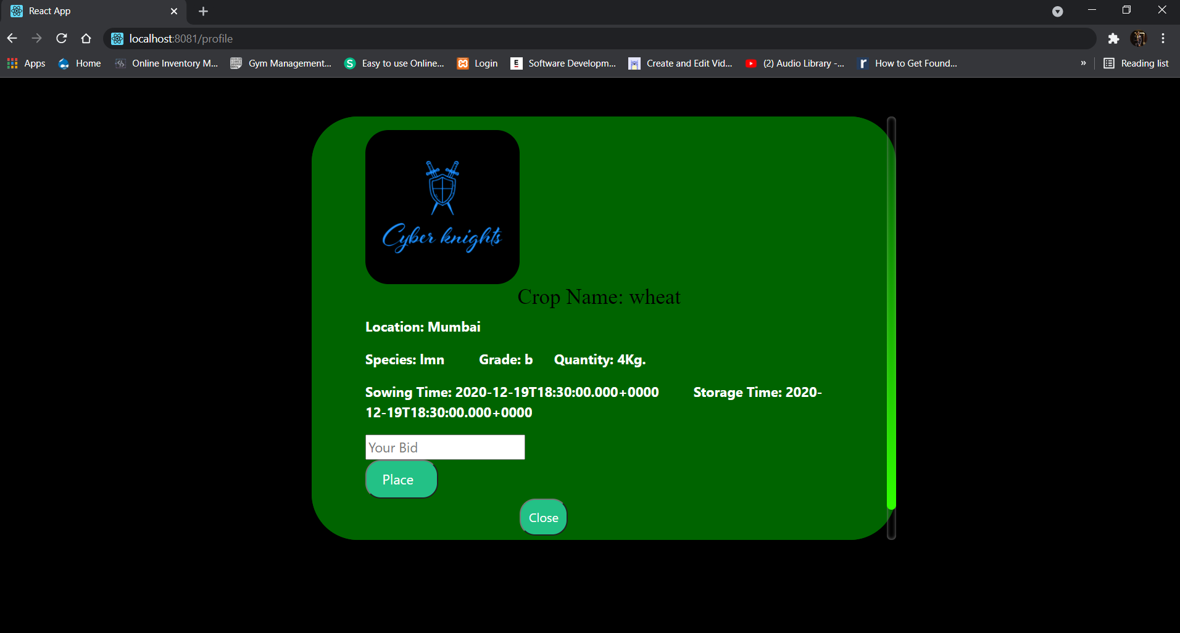

Slide 16
Drawback of conventional trading
Farmer might not get the best market value for the goods.
The trader is not able to explore various qualities of crops.
Travel expenses are high to visit location physically.
Chances of wastage of crop is more.
Time taken to carry out a deal is more.

Slide 17
Advantages of E-Mandi
Estimated cultivation time is provided.
Time taken to carry out multiple deal is less.
The farmers will get the desired market value for the goods.
The traders will explore more qualities of the crops.
The farmer can easily communicate with multiple bidders.
No travel expense is required .
Chances of crop wastage is less.

Slide 18
Future Scope
Delivery options can be implemented to nearby locations.
Chat box can be provided for interaction between farmers and traders.
Additional features can be added by creating mobile application.
Transport pooling can be provided along side so that overall cost reduces.
Predictions of crop that can be cultivated in a certain region according to geographical conditions can be provided.

Slide 19


